Slide 1
Project III:
HDB Resale Price Prediction
Ameer
Benjamin
Leonard
Wei Yu

Slide 2

Problem Statement
How can we offer competitive pricing advice for clients looking to buy or sell HDB resale flats?

Slide 3
Agenda
01
Overview of Dataset and Limitations
02
Exploratory Data Analysis
03
Predictive Modelling (App) and Recommendations
04
Retrospective

Slide 4
Dataset Overview
Original: 150634 rows, 78 columns
After: 103104 rows, 45 columns
Removed irrelevant columns and outliers
Checked for nulls and dropped them
Created a table containing average mall nearest distance by town
Fill empty values in the mall nearest distance with the average mall nearest distance by town
Notes:
We combined matured/non matured estate and hot encoded certain columns.
Imported ‘train.csv’
Checked number of rows and columns
Checked for duplicates in ID
Dropped unnecessary columns
Checked for Nulls
Created a table containing average mall nearest distance by town
Join tables to impute and fill empty values in the mall nearest distance with the average mall nearest distance by town.
Dropped the column merged in the previous step.
Changed ‘Tranc_YearMonth’ to Datetime type
Changed ‘floor_area_sqm’ to int type
Changed ‘Commercial’, ‘Multistorey_carpark’, ‘precinct_pavillion’ to 1 and 0s.
Remove Outliers by IQR

Slide 5
Dataset Limitations
Supply of resale HDB flat
Household Upgraders
01
Insufficient Data
HDB Financing Method (i.e. bank loan, HDB grants)
Demographic Data
Notes:
Insufficient data Only has a range of floor levels rather than the specific number
Unable to see how they financed the flat
MSR: MSR is capped at 30% of a borrower's gross monthly income
TDSR: To calculate a borrower's TDSR, use the following formula: (Borrower's total monthly debt obligations / Borrower's gross monthly income) x 100%.
ABSD is dependent of types of transaction (i.e) SC buying their second residential properly, Singapore Permanent Residents buying their second residential property
Housing Grants are grouped by household type.
HDB loan is at a fixed interest rate of 2.6% while bank loans could be floating or fixed at different rates

Slide 6
External Factors (Government Policies)
2014 - 2016
2013
2020
Cooling Measures Introduced
Global Oil-Price Slump
COVID-19 Increased Resale Prices
Mortgage Servicing Ratio (MSR) and Total Debt Servicing Ratio (TDSR)
Coincided with a ~1 % dip in housing prices
COVID-19 Delays in BTO Completion and the Fed cutting interest rate to 0.25%
Notes:
2014: Resale prices fell ~6.1%
“The falling resale prices are due to the potent combination of the government’s measures to stabilise the public housing market such as, reducing the
three-year wait for new PRs before they can buy resale HDB flats, and allowing singles to buy two-room BTO flats in non-mature estates.”
2014–2016: global oil-price slump of 2014–2015 coincided with a ~1 % dip in housing prices
2019: Market stabilised; prices edged up slightly (+0.4% YoY) with growing transaction volume (+3.4%) due to EHG & the Fed cutting rates
2020-2021: COVID-19 Delays in BTO Completion and the Fed cutting interest rate to 0.25% pushed resale prices upwards.

Slide 7
ABSD for Singaporean Citizens
 | From 8 Dec 2011 | On or before 5 July 2018 | On or after 6 July 2018 | On or after 16 Dec 2021 | On or after 27 Apr 2023
Second property | 3% | 7% | 12% | 17% | 20%
Third and more | 3% | 10% | 15% | 25% | 30%
Notes:
Increased ABSD might cause HDB resale demand to spike, when people sell off private property before buying HDB (to avoid ABSD) or choose resale HDB flats instead of buying second private properties. Especially for larger resale flats (5-room, executive) and flats in prime areas.

Slide 8
Exploratory Data Analysis
Market Movement Over Time
Flat Type Performance
Location Dynamics

Slide 9
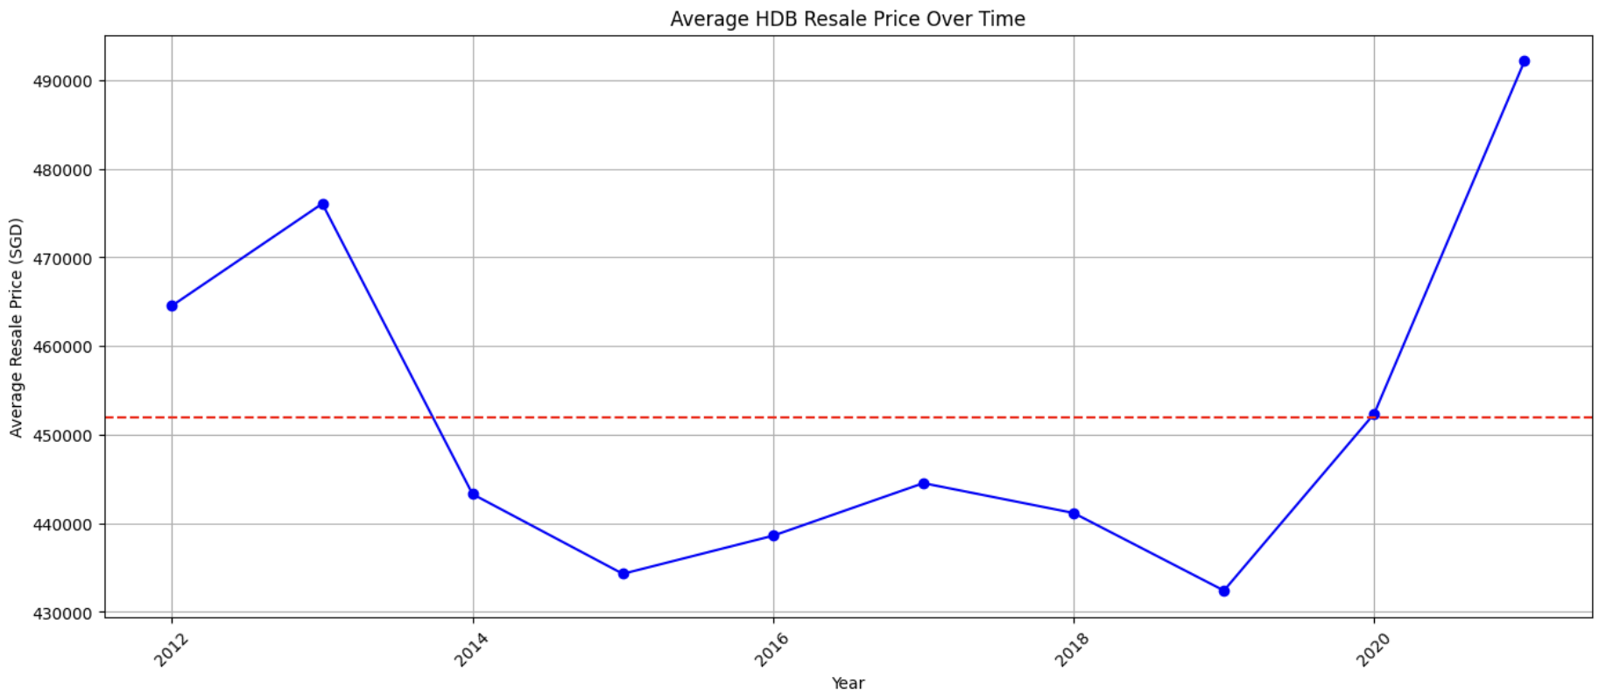
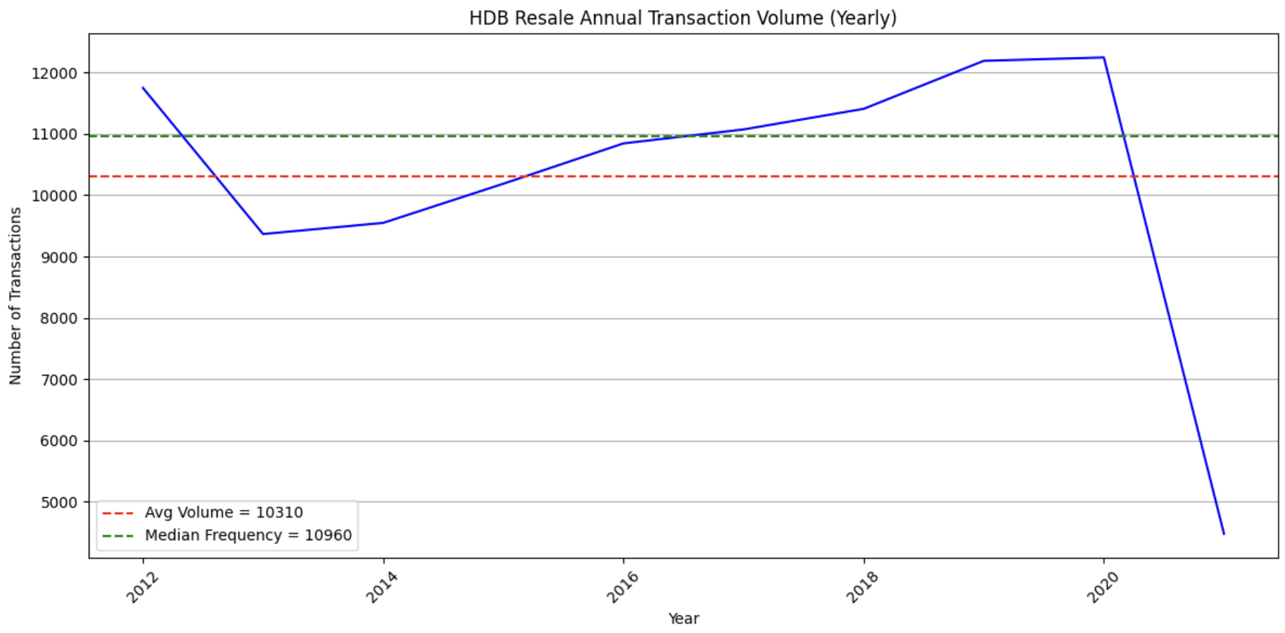
EDA: Market Movement Over Time
HDB Resale Prices and trends over time
Average Transaction Volume and Frequency Over Time
Notes:
Covid started in 2020, transaction volume dropped make sense at the start of 2020.. But the price of resale increase at the same time, bcos of BTO delays..
Drop prices in 2013-2014, because of cooling measures implemented.

Slide 10
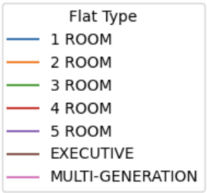
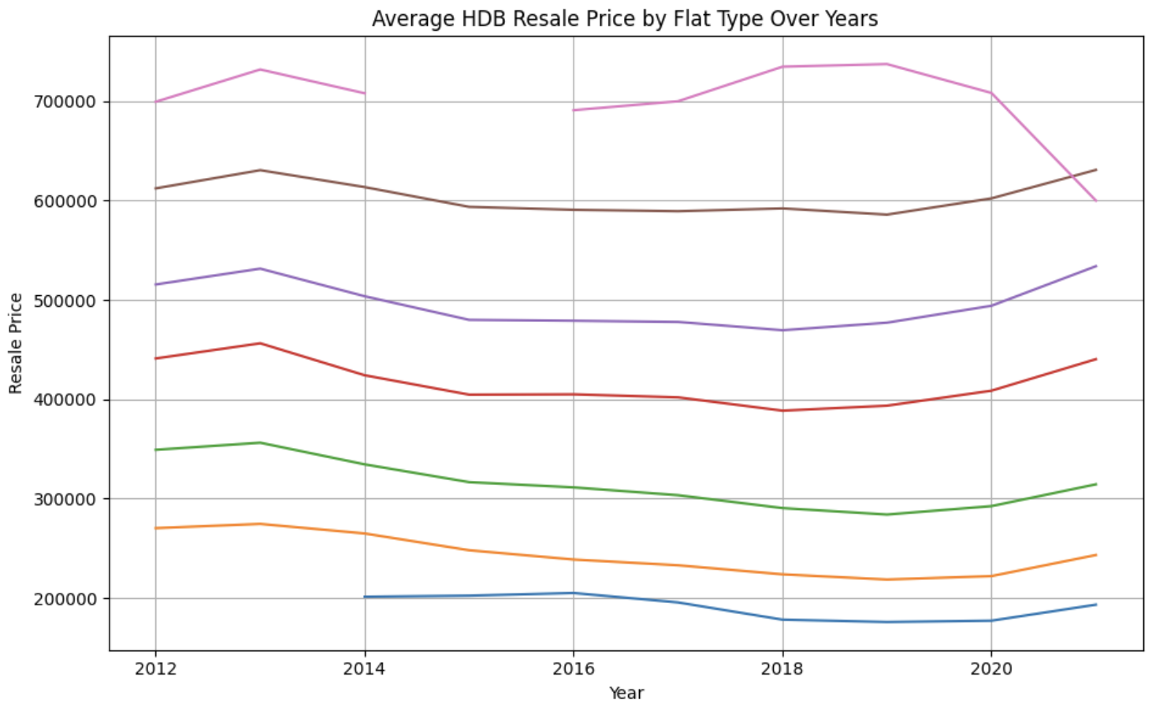
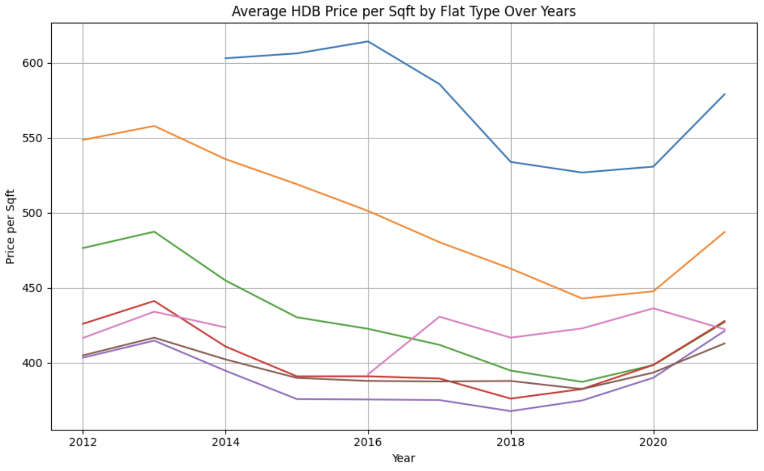
EDA: Flat Type by Performance
Average Resale Price per Flat Type Over Time
Average HDB Price per Sqft by Flat Type Over Time

Slide 11
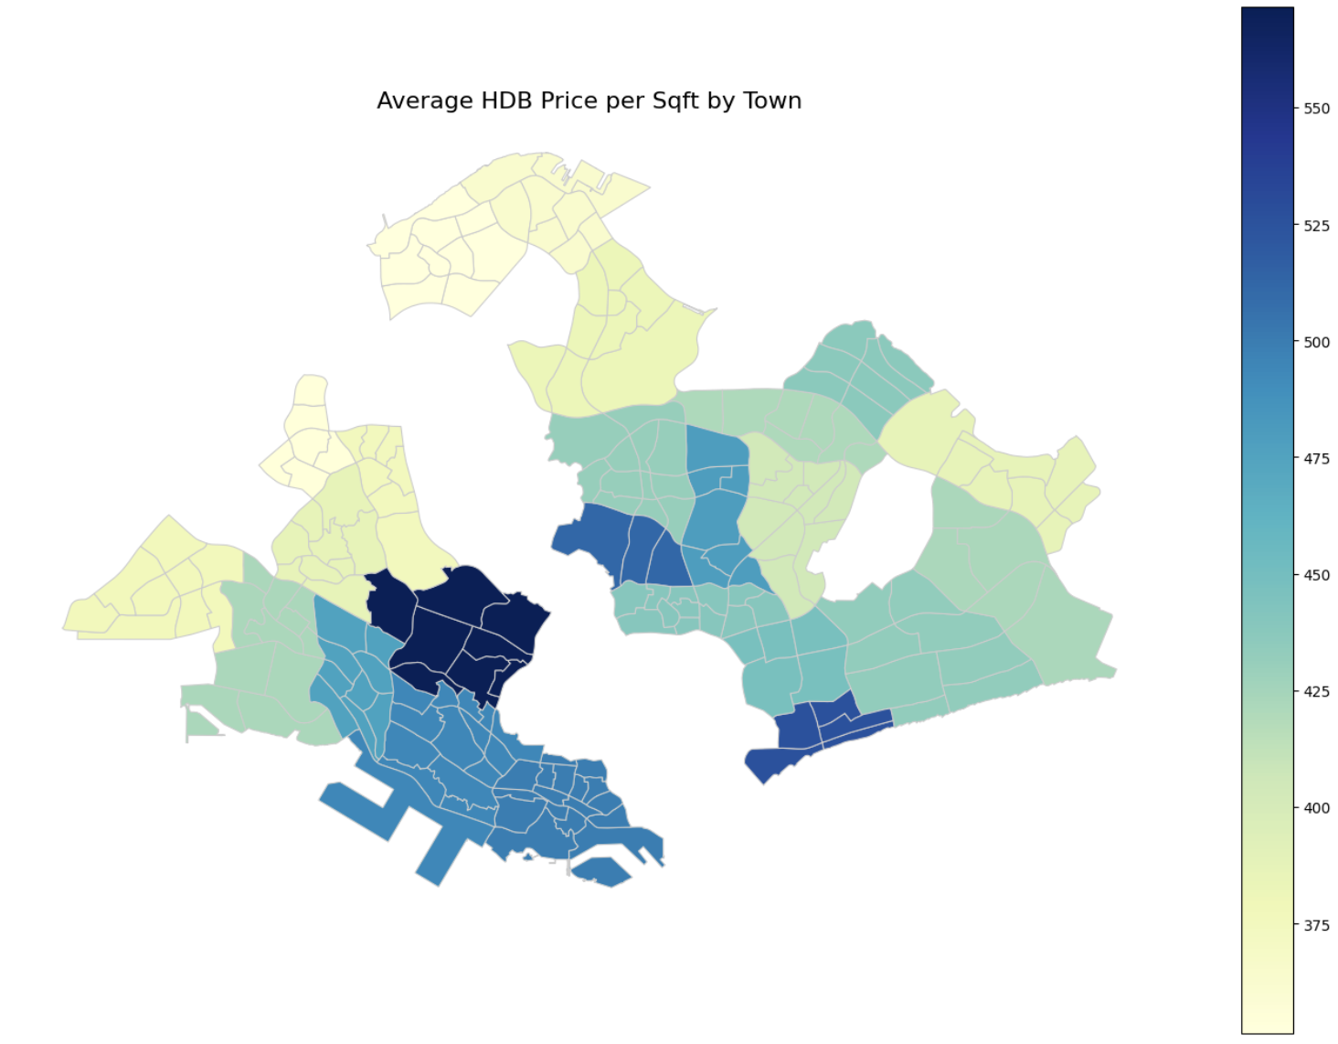
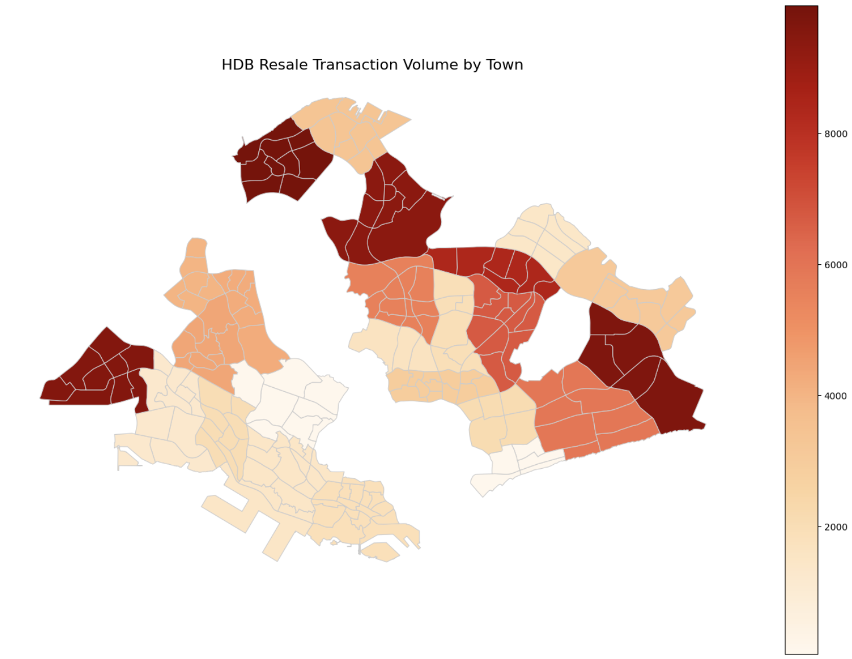
EDA: Location Dynamics

Slide 12
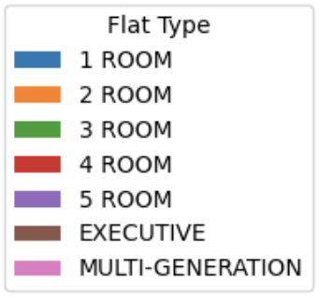
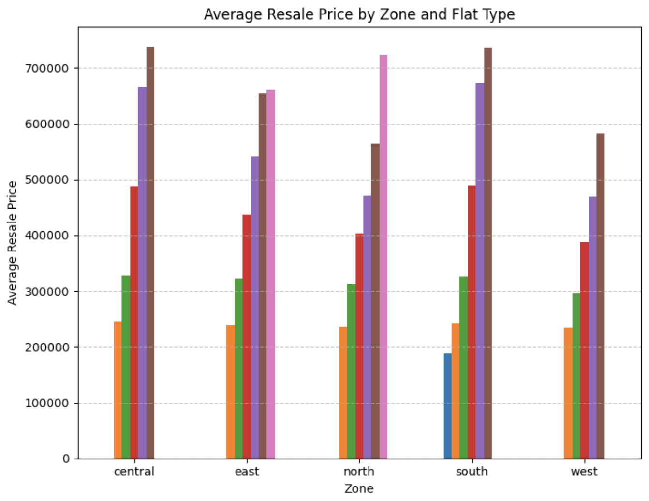
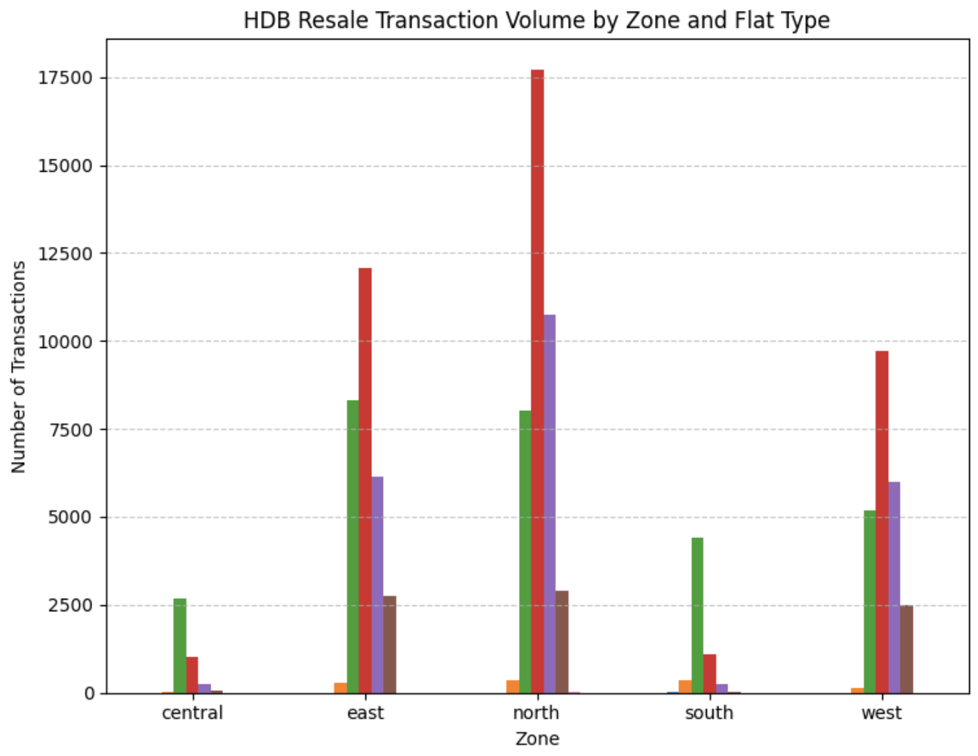
EDA: Location Dynamics
Notes:
Central has the least number of transactions, which might explain why it was dropped as the baseline when we hot-encoded zone.
So it is underrepresented in our dataset and our model might underpredict resale prices in Central. And it being the baseline could mean that the model will tend to underpredict prices. The model’s bias toward the majority class, which is the north, could also contribute to the underestimation of price.

Slide 13
Predictive Modelling: Choosing Numerical Features
floor_area_sqm
0.72
exec_sold
0.46
5room_sold
0.30
max_floor_lvl
0.23
hdb_age
-0.36
total_dwelling_units
-0.42
3room_sold
-0.49
Notes:
Numerical features: Used correlation w resale_price in feature selection. Dropped id & ppsf.

Slide 14
Predictive Modelling: Choosing Categorical Features
north
39724
east
29555
west
23518
south
6203
central
4033
Notes:
Categorical features. Used valuecounts function. These 5 zones in the data were distinguished in value, ideal for modelling. The decision process was iterative, originally we considered the 28 districts, the flat type, & also the storey level.

Slide 15
Linear Regression v.s. Random Forest
R-Squared
86.8%
RMSE
40017
R-Squared
69.2%
RMSE
61065
Notes:
RMSE & R2 (model error magnitude/variance & model accuracy of prediction). Strengths/Weaknesses/Assumptions: Linearity & Outlier sensitivity/robustness.

Slide 16
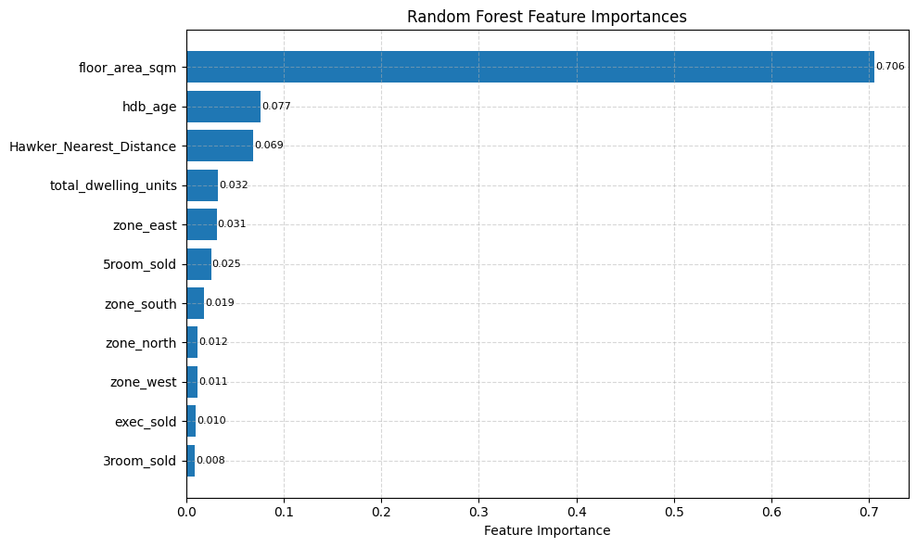
Predictive Modelling: Features Importance
Notes:
Random forest regression has a built-in feature importance calculation. Here are our chosen features ranked by contribution. Extra takeaway is that zone added up is 0.073, 3rd ranked.

Slide 17
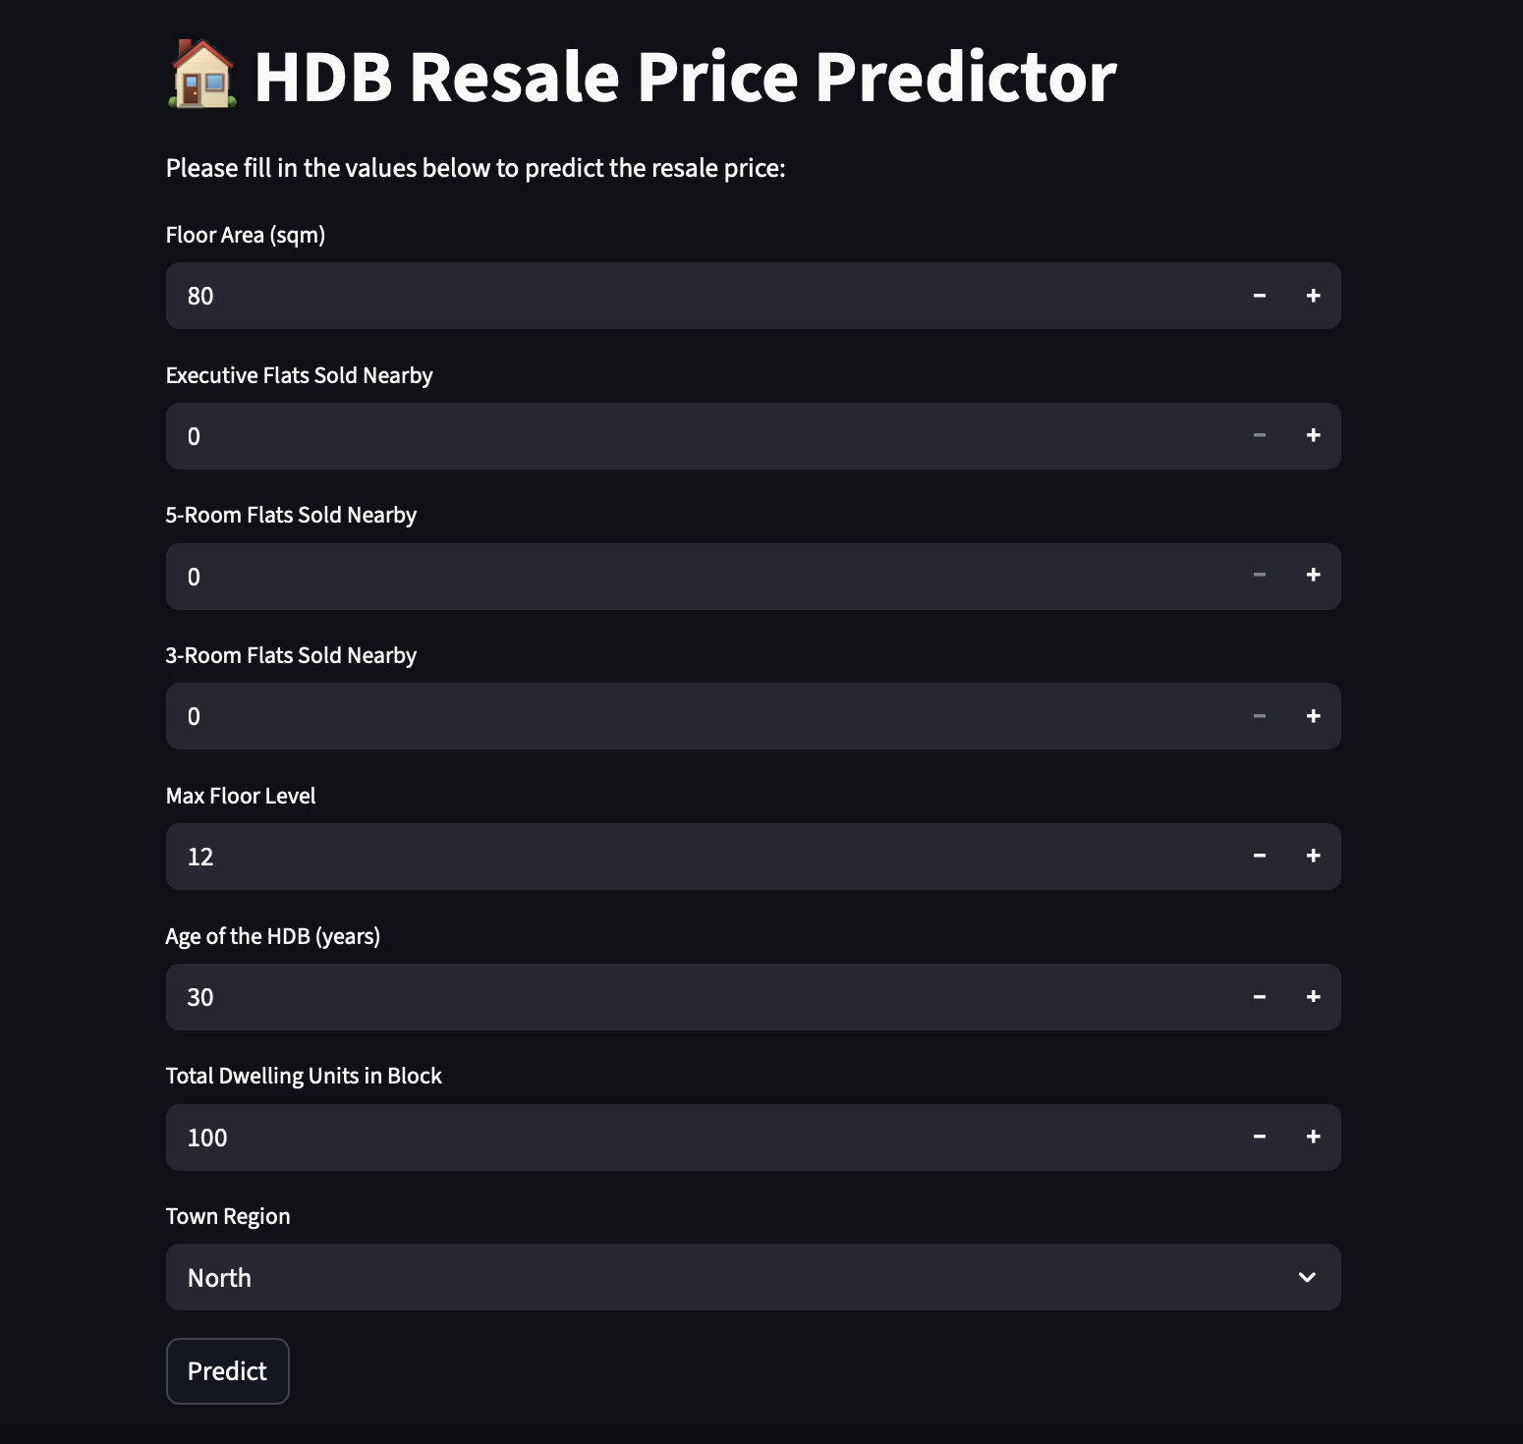
Price Prediction App

Slide 18
Challenges
Time Crunch
Delegation
Unforeseen Tasks
Workflow
Proactiveness
Collaborative Spirit
Taking Initiatives
System Developed

Slide 19
Future Steps
1
Project Management
2
Time Allocation
3
Code Practices
4
Workflow Optimization

Slide 20
Recommendation
HDB Age
Floor Area (sqm)
Executive Flats Sold Nearby
3-Room Flats Sold Nearby
5-Room Flats Sold Nearby
Total_dwelling_units
Max Floor Level
zone

Slide 21
Conclusion
By implementing the recommendations, we can establish a business model that not only guides buyers and sellers but also builds long-lasting relationships based on trust and transparency.

Slide 22
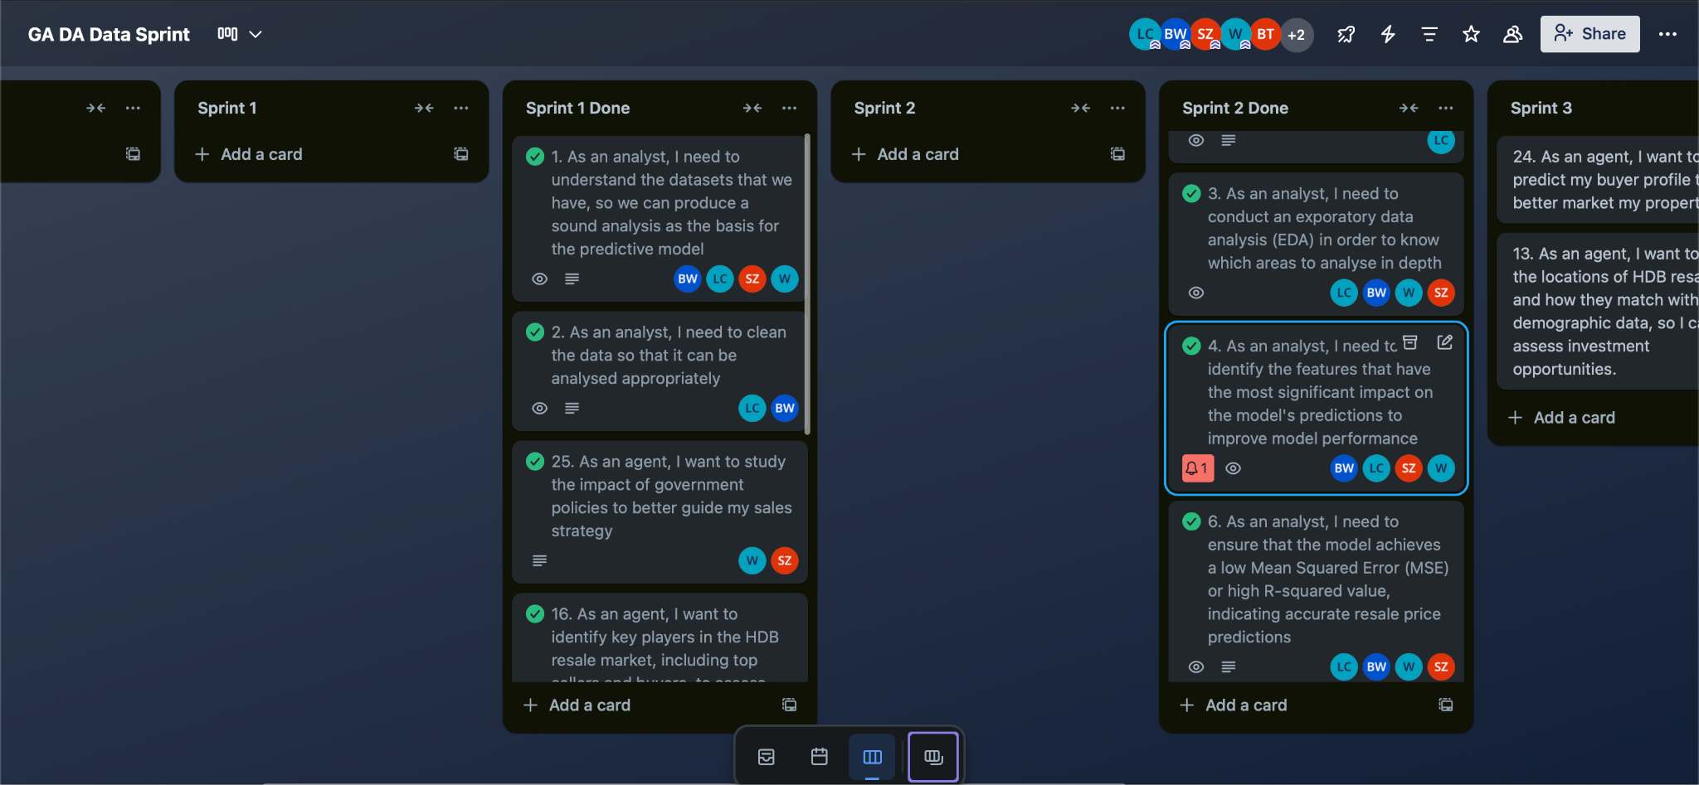
Trello

